Slide 1
STORAGE Virtualization
Notes:
Module – 4
Virtualized Data Center – Storage

Slide 2
Objectives
Explain storage virtualization and its implementation
Explain virtual machine storage options
Describe block and file level storage virtualization
Describe virtual provisioning and automated storage tiering
Notes:
This module focuses on storage virtualization implementation, key underlying technologies, and methods for providing virtual storage to compute systems in a VDC environment.

Slide 3
Storage Virtualization
Storage virtualization
It is the process of masking the underlying complexity of physical storage resources and presenting the logical view of these resources to compute systems.
Logical to physical storage mapping is performed by virtualization layer
Virtualization layer abstracts the identity of physical storage devices
Creates a storage pool from multiple, heterogeneous storage arrays
Virtual volumes are created from the storage pools and are assigned to the compute system
Notes:
Storage virtualization is the process of masking the underlying complexity of physical storage resources and presenting the logical view of these resources to compute systems in a VDC environment. Storage virtualization enables creating one or more logical storage on the physical storage resources. This logical or virtual storage appears as physical storage to the compute systems. The logical to physical storage mapping is performed by storage virtualization layer. The virtualization layer abstracts the identity of physical storage devices and creates a storage pool by aggregating storage resources from multiple heterogeneous storage arrays.
Virtual volumes are created from these storage pools and are assigned to the compute system. Compute system remains unaware of the mapping operation and access the virtual volumes, as if accessing physical storage attached to them.

Slide 4
Benefits of Storage Virtualization
Adds or removes storage without any downtime
Increases storage utilization thereby reducing TCO
Provides non-disruptive data migration between storage devices
Supports heterogeneous, multi-vendor storage platforms
Simplifies storage management
Notes:
Storage virtualization enables adding or removing storage without affecting application availability. It increases storage utilization by consolidating multiple heterogeneous storage resources and creating storage pools. Storage pools provide flexibility in storage resources allocation to the compute system and increase storage utilization. This considerably reduces investment in new storage resources and thereby lowers the Total Cost of Ownership (TCO).
Data migration is required during technology refresh initiatives where newer storage systems replace the legacy storage systems. It may also be required to move data between different storage systems when performance and availability requirements change. Storage virtualization enables non-disruptive data migration (data is being accessed while migrations are in progress) between storage systems since it masks the complexity of underlying physical storage resources. It also enables support of heterogeneous, multi-vendor storage platforms.
In a virtual environment, different virtual machines running different applications can exist on a single compute system. This creates a very complex environment as there exist multiple sets of workloads and requirements. It can be extremely challenging to manage such an environment in a traditional storage environment. However, by implementing storage virtualization, the complexity in storage provisioning is removed from the environment. Features such as storage pools, storage tiering, and virtual provisioning are key advances in storage technologies that provide this simplification. You will learn about these features later in this module.

Slide 5
Storage Virtualization at Different Layers
Layers | Examples
Compute | Storage provisioning for VMs
Network | Block-level virtualization File-level virtualization
Storage | Virtual Provisioning Automated Storage Tiering
Notes:
Storage virtualization may be implemented at compute, network, and storage layers. At the compute layer, hypervisor allocates storage space for VMs without exposing the complexity of the physical storage. Block and file level virtualization are network-based virtualization techniques which embed intelligence of virtualizing storage resources at network layer. At storage layer, both virtual provisioning and automated storage tiering simplify the storage management and help to optimize the storage infrastructure. You will learn about each of these concepts later in this module.

Slide 6

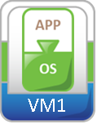















Storage for Virtual Machines
Compute 1
Compute 2
VMs are stored as set of files on storage space available to hypervisor
‘Virtual disk file’ represents a virtual disk used by a VM to store its data
Size of virtual disk file represents storage space allocated to virtual disk
VMs remain unaware of
Total space available to the hypervisor
Underlying storage technologies
VM 3
VM 4
Virtual disk file
Virtual disk file
Virtual disk file
Virtual disk file
VMFS
NFS
FC SAN
IP Network
FC Storage
iSCSI
NAS
Notes:
A ‘Virtual Machine’ is stored as a set of ‘files’ on the storage devices assigned to the hypervisor. One of the file called ‘virtual disk file’ represents a ‘virtual disk’ which is used by a VM to store its data. The virtual disk appears as a local physical disk drive to the VM. The size of the ‘virtual disk file’ represents the storage space allocated to the ‘virtual disk’.
Hypervisor may access FC storage device, or IP storage devices such as iSCSI, and NAS devices. Virtual machines remain unaware of the total storage space available to the hypervisor and the underlying storage technologies.

Slide 7
File System for Managing VM Files
Hypervisor uses two file systems to manage the VM files
Hypervisor’s native file system called Virtual Machine File System (VMFS)
Network File System (NFS) such as NAS file system
Notes:
Virtual machine files could be managed by hypervisor’s native file system, called Virtual Machine File System (VMFS), or Network File System (NFS) such as NAS file system. These two file systems are discussed in subsequent slides.

Slide 8




Virtual Machine File System (VMFS)
Compute 1
Compute 2
Hypervisor’s native file system to manage VM files
Cluster File System
Can be accessed by multiple compute systems simultaneously
Provides on-disk locking
Uses a VMFS volume to store VM files
Virtual disk
Virtual disk
Virtual disk
Virtual disk
VMFS Volume
Notes:
Virtual Machine File System (VMFS) is the native file system for hypervisor. It is a simple, efficient, cluster file system that allows multiple compute systems to read and write to the same storage simultaneously. It provides on-disk locking to ensure that the same virtual machine is not powered on by multiple compute systems at the same time. If a compute system fails, the on-disk lock for each virtual machine running on the failed compute system can be released so that virtual machines may be restarted on other compute system. VMFS volume is used for providing storage space for creating Virtual Machine File System to store virtual machine files.

Slide 9


Dynamic Expansion of VMFS
Expand VMFS on the existing volume
VMFS can be dynamically expanded without disrupting running VMs
VMFS
Methods to expand VMFS
Expand VMFS dynamically on the volume partition on which it is located
Add one or more LUNs to the source VMFS volume
LUN - Logical Unit Number
Add a LUN to the existing VMFS volume
VMFS Volume
LUN
VMFS Volume
Notes:
Hypervisors support Logical Volume Manager (LVM) for extending VMFS dynamically without disrupting the running VMs across compute systems. There are two ways by which the VMFS can be dynamically expanded. The first method allows to expand VMFS dynamically on the volume partition on which it is located. The second method allows to expand the capacity of VMFS volume by adding one or more LUNs to the source VMFS volume to create a large one.

Slide 10



Raw Device Mapping
Enables VM to directly access LUNs in a storage system
Contains a symbolic link on VMFS volume to the LUN
Acts as a proxy that allows direct access to a LUN
VM1
VM2
VM Content
Mapping File
VMFS Volume
Benefits
VM Content
Provides solution when huge volume of data on LUN is not practical to move onto virtual disk
Enables clustering the VM with physical machine
LUN on Physical Storage System
Notes:
Virtual machines can store data directly on a LUN in the storage system instead of storing its data in a virtual disk file on a VMFS volume. Storing data in this way is useful when the applications running on the VMs are required to know the physical characteristics of the storage device. Raw Device Mapping provides a mechanism for a virtual machine to have direct access to a LUN on the physical storage subsystem (FC or iSCSI). It is a special file in a VMFS volume that acts as a proxy for the LUN in the storage system. RDM is recommended when there is large amount of data on the LUN in the storage system and it is not practical to move onto a virtual disk. It is also used when clustering virtual machine with physical machine. In this case, the virtual machine is required to access the LUN which is being accessed by physical machine.

Slide 11
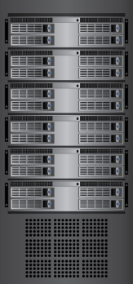
Network File System
Compute 1
Compute 2
Hypervisor uses NFS protocol to access NAS file system
NAS - Network Attached Storage
NFS volumes are created on NAS device
Provide storage to VM
Accessed by multiple compute systems simultaneously
Virtual disk
Virtual disk
Virtual disk
Virtual disk
NFS Volume
NAS System
Notes:
Hypervisor supports NAS system through the NFS protocol. The NFS protocol enables communication between NFS client and NFS server. Hypervisors come with NFS client software for NFS server (NAS) access. The NFS file system must be mounted on the compute system in order to allow NFS volumes to provide storage for all VMs. Provisioning of storage to virtual machines from NFS volume(s) is similar to provisioning from VMFS volume. NFS volume is managed entirely by the NAS system.

Slide 12
Block-level and File-level Virtualization – Overview
Network-based virtualization embeds storage virtualization intelligence at the network layer
Provides ability to
Pool heterogeneous storage resources
Perform non-disruptive data migration
Manage a pool of storage resources from a single management interface
Network-based storage virtualization is applied at
Block-level (SAN) – Storage Area Network
File-level (NAS) – Network Attached Storage
Notes:
Network-based storage virtualization embeds the intelligence of virtualizing storage resources at network layer and provides an abstract view of physical storage resources. When an I/O is sent from the compute system, it is redirected through the virtualization layer at the network to the mapped physical storage. Virtualization applied at the network enables to pool multi-vendor storage resources and to manage these pools from a single management interface. It also enables non-disruptive data migration between arrays. Network-based storage virtualization can be implemented in both SAN and NAS environments. In a SAN, virtualization is applied at the block level, whereas in NAS, it is applied at the file level.

Slide 13
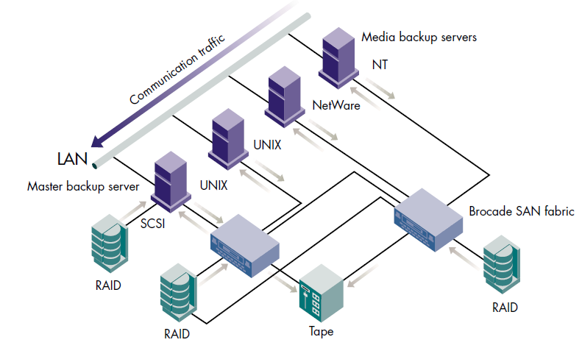
Storage Area Network
http://www.allsan.com/sanvendors.php3

Slide 14
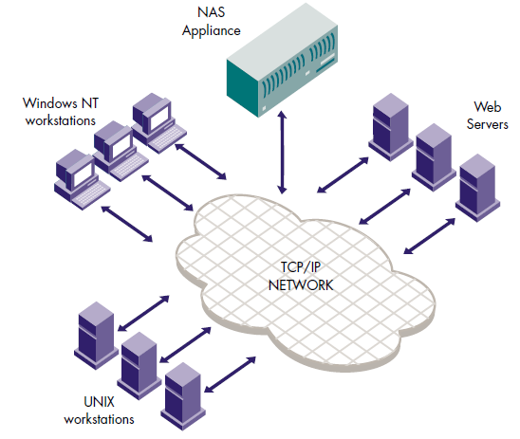
Network Attached Storage
http://en.wikipedia.org/wiki/List_of_NAS_manufacturers

Slide 15
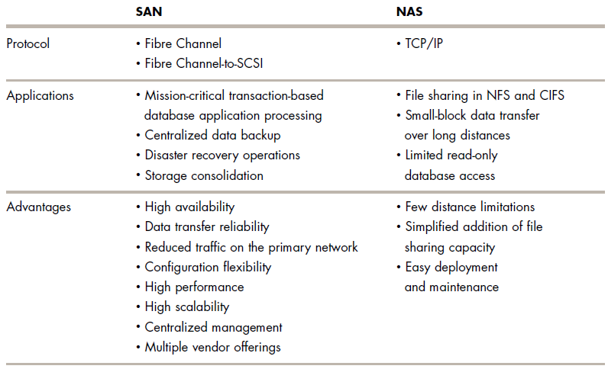
SAN vs NAS

Slide 16



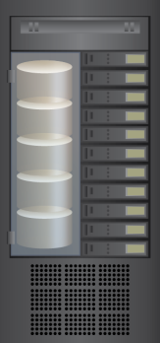
Block-level Storage Virtualization
Creates an abstraction layer at SAN, between physical storage resources and volumes presented to compute
Uses virtualization appliance to perform mapping operation
Makes underlying storage infrastructure transparent to compute
Enables significant cost and resource optimization
Compute
Virtual volume
SAN
Virtualization Appliance
Heterogeneous Storage Arrays
Notes:
Block-level storage virtualization creates an abstraction layer in the SAN, between physical storage resources and virtual volumes presented to the compute systems. Instead of being directed to the LUNs on the individual storage arrays, the compute systems are directed to the virtual volumes on the virtualization appliance at the network. The virtualization appliance performs mapping between the virtual volumes and the LUNs on the arrays. Block-level storage virtualization enables us to combine several LUNs from one or more arrays into a single virtual volume before presenting it to the compute systems. It also takes a single large LUN from an array, slices it into smaller virtual volumes, and presents these volumes to the compute systems. Block-level storage virtualization supports dynamic increase of storage volumes, consolidation of heterogeneous storage arrays, and transparent volume access.
With block-level virtualization solution in place, the virtualization appliance at the network handles the migration of data. The virtualization appliance enables storage volumes to remain online and accessible while data is being migrated. After data is migrated from one array to another, no physical changes are required because the compute system still points to the same port on the virtualization appliance. However, the mapping on the virtualization appliance should be changed to point to the new location. These changes can be performed online with no impact to end the user data access. Deploying block-level storage virtualization in heterogeneous arrays environment facilitates an Information Lifecycle Management (ILM) strategy, enabling significant cost and resource optimization. Low-value data can be migrated from higher performance to appropriate performance arrays or disks.

Slide 17



Physical to Virtual Volume Mapping
Compute
Compute
Virtualization Appliance
Virtual volume
Virtual volume
Extent
Extent
Extent
Extent
Storage Volume
Storage Volume
Storage Volume
Storage Volume
Storage Array
Storage Array
Notes:
The virtualization appliance encapsulates physical storage devices and applies layers of logical abstraction to create virtual volumes. These virtual volumes are presented to the compute system.
Storage volume is a device or LUN on an attached storage system that is visible to the virtualization appliance. The available capacity on a storage volume is used to create extent and virtual volumes. Extents are mechanisms a virtualization appliance uses to divide storage volumes. Extents may be all or part of the underlying storage volume. The virtualization appliance aggregates these extents and applies RAID protection to create virtual volumes.

Slide 18

File-level Storage Virtualization
Clients
Provides an abstraction in the NAS/File servers environment
Eliminates dependencies between the file and its location
Enables movement of files between NAS systems without impacting client access
Provides opportunities to optimize storage utilization
Implemented using global namespace
Virtualization Appliance
IP
IP Network
Multi-vendor NAS Systems
Notes:
File-level storage virtualization provides an abstraction in the NAS environment and eliminates dependencies between the file and its physical location. Before file-level virtualization, each client knows the exact location of its file-level resources. In a data center, migrating data from a NAS to another NAS may be required for technology refresh, performance requirements, and non-availability of additional storage capacity. However, it is not easy to move files across this environment, and this requires downtime for NAS systems. Moreover, clients need to be reconfigured with the new path. This makes it difficult for storage administrators to improve storage efficiency, while maintaining the required service level.
File-level virtualization simplifies file mobility. File virtualization appliance at the network creates a logical pool of storage and enables users to use a logical path, rather than a physical path to access files. File virtualization facilitates the movement of files between the NAS systems without any downtime i.e., clients can access their files non-disruptively while the files being migrated. Global namespace is used to map the logical path of a file to the physical path names.

Slide 19
File-level Storage Virtualization – Global Namespace
Enables clients to access files using logical names which are independent of the actual physical location
Maps logical path of a file to the physical path names
Simplifies access to files
Clients no longer need to have multiple mount points to access data located on different NAS devices
Notes:
Namespace provides an abstraction layer, enabling clients to use a logical name that is independent of the actual physical location. Typically, with a standard file system such as NTFS, a namespace is associated with a single machine or file system. By bringing multiple file systems under a single namespace, global namespace provides a single view of the directories and files. It also provides administrators a single control point for managing files.

Slide 20



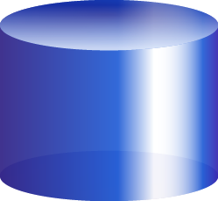

Virtual Provisioning (Thin Provisioning)
Virtual Provisioning (Thin Provisioning)
It is the ability to present a LUN to a compute system with more capacity than what is physically allocated to the LUN.
Compute Systems
10 TB
10 TB
10 TB
Capacity-on-demand from a shared storage pool, called Thin pool
Physical storage is allocated only when the compute requires it
Provisioning decisions not bound by currently available storage
May be implemented at
Storage layer
Compute layer – virtual Provisioning for virtual disk
Thin LUN
Thin LUN
Thin LUN
Compute
Reported Capacity
3 TB
Allocated
4 TB
Allocated
3 TB
Allocated
Disk Drives
Shared Storage pool
(Thin Pool)
Notes:
One of the biggest challenges for storage administrators is balancing the storage space required by various applications in their data centers. Administrators typically allocate storage space based on anticipated storage growth. They do this to reduce the management overhead and application downtime required to add new storage later on. This generally results in the over-provisioning of storage capacity, which leads to higher costs, increased power, cooling, and floor space requirements, and lower capacity utilization. These challenges are addressed by Virtual Provisioning.
Virtual Provisioning is the ability to present a logical unit (Thin LUN) to a compute system, with more capacity than what is physically allocated to the LUN on the storage array. Physical storage is allocated to the application “on-demand” from a shared pool of physical capacity. This provides more efficient utilization of storage by reducing the amount of allocated, but unused physical storage. You will learn about Thin LUN and Thin pool later in this lesson.

Slide 21

Traditional Provisioning vs. Virtual Provisioning
150 GB
Available
Capacity
1500 GB
or
1.5 TB
Allocated
Unused
Capacity
1650 GB
or
1.65 TB
Available
Capacity
800 GB
550 GB
600 GB
Allocated
Unused
Capacity
500 GB
400 GB
Allocated
Unused
Capacity
500 GB
Allocated
Unused
Capacity
350 GB
Actual data
350 GB
Actual data
100 GB Data
200 GB Data
100 GB Allocated
50 GB Allocated
200 GB Allocated
50 GB Data
LUN 1 500 GB
LUN 2 550 GB
LUN 3 800 GB
Storage System 2 TB
Thin LUN 1
Thin LUN 2
Thin LUN 3
Storage System 2 TB
Traditional Provisioning
Virtual Provisioning
Notes:
The example shown on this slide compares virtual provisioning with traditional storage provisioning. The example demonstrates the benefit of better capacity utilization.
Let us assume that three LUNs are created and presented to one or more compute systems using traditional provisioning methods. The total usable capacity of the storage system is 2 TB.
The size of LUN 1 is 500 GB, of which 100 GB contains data and 400 GB is allocated, but unused.
The size of LUN 2 is 550 GB, of which 50 GB contains data and 500 GB is allocated, but unused.
The size of LUN 3 is 800 GB, of which 200 GB contains data and 600 GB is allocated, but unused.
In total, the storage system contains 350 GB of actual data, 1.5 TB of allocated, but unused capacity, and only 150 GB of capacity available for other applications. Now, let us assume that a new application is installed in the data center and requires 400 GB storage capacity. The storage system has only 150 GB of available capacity. So, it is not possible to provide 400 GB storage to the new application even though 1.5 TB of unused capacity is available. This shows the under utilization of storage in a traditional storage provisioning environment.
If we consider the same 2 TB storage system with Virtual Provisioning, the differences are quite dramatic. Although the system administrator creates the same size LUNs, there is no allocated unused capacity. In total, the storage system with Virtual Provisioning has 350 GB of actual data and 1.65 TB of capacity available for other applications, versus only 150 GB available in the traditional storage provisioning method.

Slide 22
Thin LUN
Logical device where the physical storage need not be completely allocated at the time of creation
Seen by the operating system as a traditional LUN
Physical storage is allocated to the Thin LUN from the Thin pool
Minimum amount of physical storage allocated at a time to a Thin LUN from a Thin Pool is called Thin LUN Extent
Best suited for environments, where space efficiency is paramount
Notes:
Thin LUNs are logical devices. Physical storage need not be completely allocated to them at the time of creation. Physical storage is allocated to the Thin LUNs from the Thin pool (discussed later in this lesson). ‘Thin LUN extent’ is the minimum amount of physical storage that is consumed at a time by a ‘Thin LUN’ from a ‘Thin pool’. From the operating system’s perspective, Thin LUNs appear as traditional LUNs. Thin LUNs are best suited for situations where space efficiency is paramount. They are used for applications when the storage space consumption is difficult to predict.

Slide 23
Thin Pool
Collection of physical drives that provide the actual physical storage used by Thin LUNs
Multiple pools may be created within a storage array
Can be expanded dynamically
Drives can be added to a Thin pool while pool is being used in production
Allocated capacity is reclaimed by the pool when Thin LUNs are destroyed
Thin Pool
Additional Disk Drives
Notes:
A Thin pool comprises physical drives that provide the actual physical storage used by Thin LUNs. A Thin pool is created by specifying a set of drives and a RAID type for that pool. Thin LUNs are then created out of that pool (similar to traditional LUN created on a RAID group). All the Thin LUNs created from a pool share the storage resources of that pool. Multiple pools can be created within a storage array. Adding drives to a Thin pool increases the available shared capacity for all the Thin LUNs in the pool. Drives can be added to a Thin pool while the pool is used in production. The allocated capacity is reclaimed by the pool when Thin LUNs are destroyed.

Slide 24
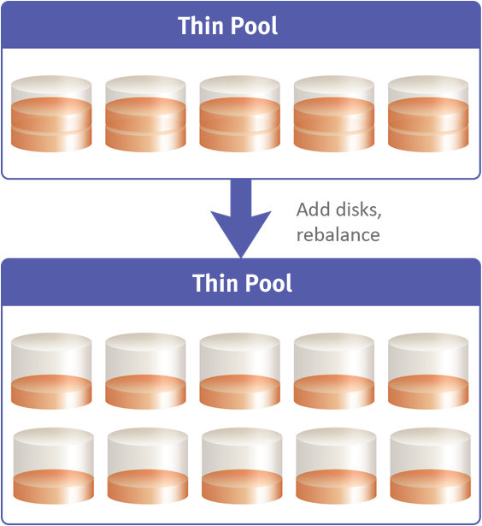
Thin Pool Rebalancing
Balances the used capacity of physical disk drives over the entire pool when new disk drives are added
Restripes data across all disk drives
Notes:
Thin pool rebalancing is a technique that provides the ability to automatically rebalance allocated extents on physical disk drives over the entire pool when new disk drives are added to the pool. Thin pool rebalancing restripes data across all the disk drives( both existing and new disk drives) in the thin pool. This enables spreading out the data equally on all the physical disk drives within the Thin pool, ensuring that the used capacity of each disk drive is uniform across the pool.

Slide 25
Virtual Provisioning at Compute
Hypervisor performs virtual provisioning to create virtual disks for VMs
Virtual machine sees full logical disk size at all times
Hypervisor allocates storage space to the virtual disk only when VM requires storage space
Eliminates the need to overprovision virtual disks
Hypervisor
Thin
Thick
Thin
10GB
20GB
40GB
20GB
100GB
Virtual Disks
Notes:
Virtual provisioning may occur at the compute level. Hypervisor performs virtual provisioning to create virtual disks for VMs.
Hypervisor offers two options for provisioning storage to virtual disk:
Provisioning thick disk
Provisioning thin disk
When Thick disk is provisioned, the entire provisioned space is committed to the virtual disk. Creating virtual disks in Thick format can lead to underutilization of virtual disks. In this case, large amounts of storage space, allocated to individual virtual machines, may remain unused.
When Thin disk is provisioned, the hypervisor allocates storage space to the virtual disk only when VM requires storage space. This eliminates the allocated, but unused storage capacity at the virtual disk.

Slide 26
Virtual Provisioning Benefits
Reduces administrative overhead
Improves capacity utilization
Reduces cost
Reduces downtime
Notes:
Virtual Provisioning reduces administrative overhead by simplifying storage provisioning to the compute systems. Storage provisioning can be done independent of the physical storage capacity. Virtual provisioning can reduce the time required to repeatedly add storage capacity to the compute systems. It improves capacity utilization by reducing the amount of allocated, but unused physical storage and also avoids over-allocation of storage to the compute systems. Virtual provisioning reduces storage and operating costs. Storage costs are reduced through increased space efficiency in primary storage because the storage is allocated as required. Virtual provisioning eliminates additional investment on high-end primary storage drives due to effective storage utilization. Operating costs are reduced considerably because fewer disks consume less power, cooling, and floor space. Virtual Provisioning is less disruptive to applications, and so, administrators do not have to continually take applications off-line to increase the storage capacity.

Slide 27
Virtual Provisioning Best Practices
Drives in Thin pool should have same RPM
Drives in the Thin pool should be of same size
Provision Thin LUNs for applications that can tolerate some variation in performance
Notes:
Drives in Thin pool should have the same RPM. If there is a mismatch, then the required performance may vary. All the drives in a pool must be of the same size because drives of different sizes may result in unutilized drive capacity. It is noted that all applications are not suited to Thin LUNs. Thin LUNs are most appropriate for applications that can tolerate some variation in performance. For applications demanding higher service levels, traditional LUNs on RAID groups would be a more suitable choice.

